Slide 1


Text-Mining: Theory, steps and ideas
Dr. J. Kasmire
Research Fellow
Cathie Marsh Institute/UK Data Service
Copyright © year Institution. Created by Organisation, UK Data Service.

Slide 2
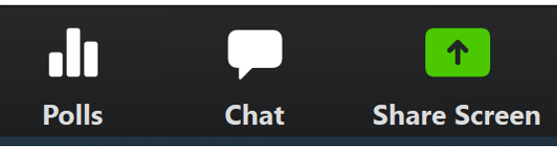
Interaction in this workshop
At any point in the workshop you can use the Zoom chat to ask the workshop facilitator about technical questions or comments.

Slide 3
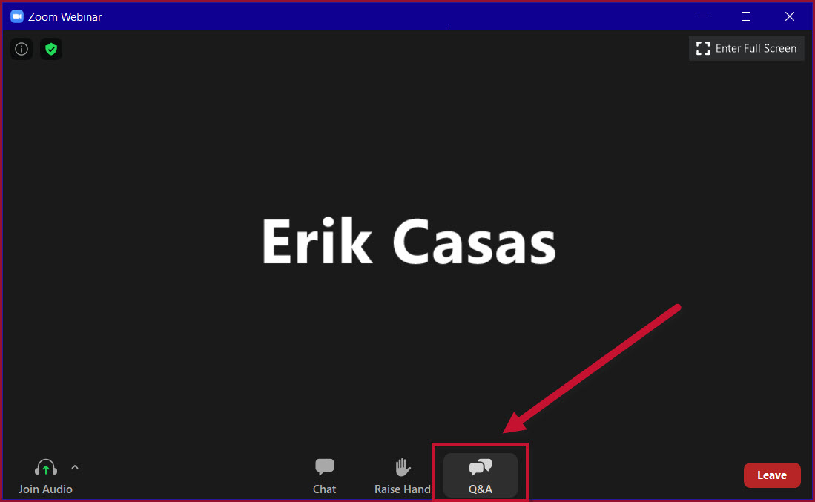
Q&A Interaction in this workshop
At any point in the workshop you can use the Zoom chat to ask the workshop facilitator about technical questions or comments.
At any point, you can ask or upvote questions for me, the workshop host, in the Zoom Q&A.

Slide 4
Mentimeter interaction in this workshop
At any point in the workshop you can use the Zoom chat to ask the workshop facilitator about technical questions or comments.
At any point, you can ask or upvote questions for me, the workshop host, in the Zoom Q&A.
There are also polls, word clouds, short answers and other interactions where the answers will appear anonymously on screen. For this, you go to menti.com and enter the 8 digit code at the top of the screen.
Let’s try it now!

Slide 5
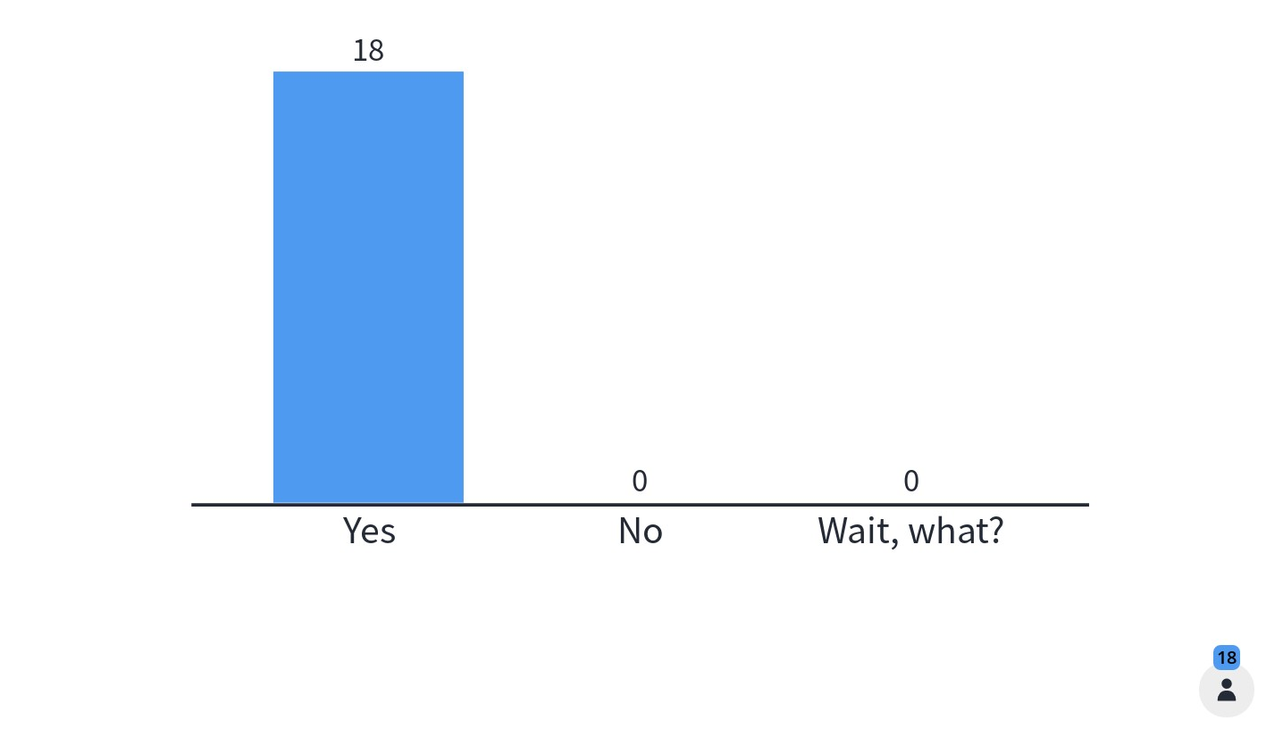
Can you hear me now?

Slide 6
Troubleshooting audio problems
Check your speaker/headset is plugged in / volume is on.
Click on audio to change to listening via phone
We are recording this webinar and will post it on YouTube (https://www.youtube.com/user/UKDATASERVICE)

Slide 7
You might be interested in other UKDS events
Accessing and using real-world study data: a Stata-based introduction for newcomers to longitudinal research
6 Mar 2023 - 23 Mar 2023 1:00 pm - 2:00 pm
Mental health and well-being research in the UK: An introduction to surveys and longitudinal data 6 Mar 2023 2:00 pm - 3:30 pm
Computational social science drop-in 14 Mar 2023 1:00 pm - 2:00 pm
https://ukdataservice.ac.uk/news-and-events/events.aspx
https://www.ukdataservice.ac.uk/news-and-events/events/past-events.aspx

Slide 8
Table of Contents for this workshop
Structure in data and text
4 basic steps of text-mining
Processing in more detail
Analysis in more detail
Resources
Break!
Out of PowerPoint and into Jupyter Notebooks!

Slide 9
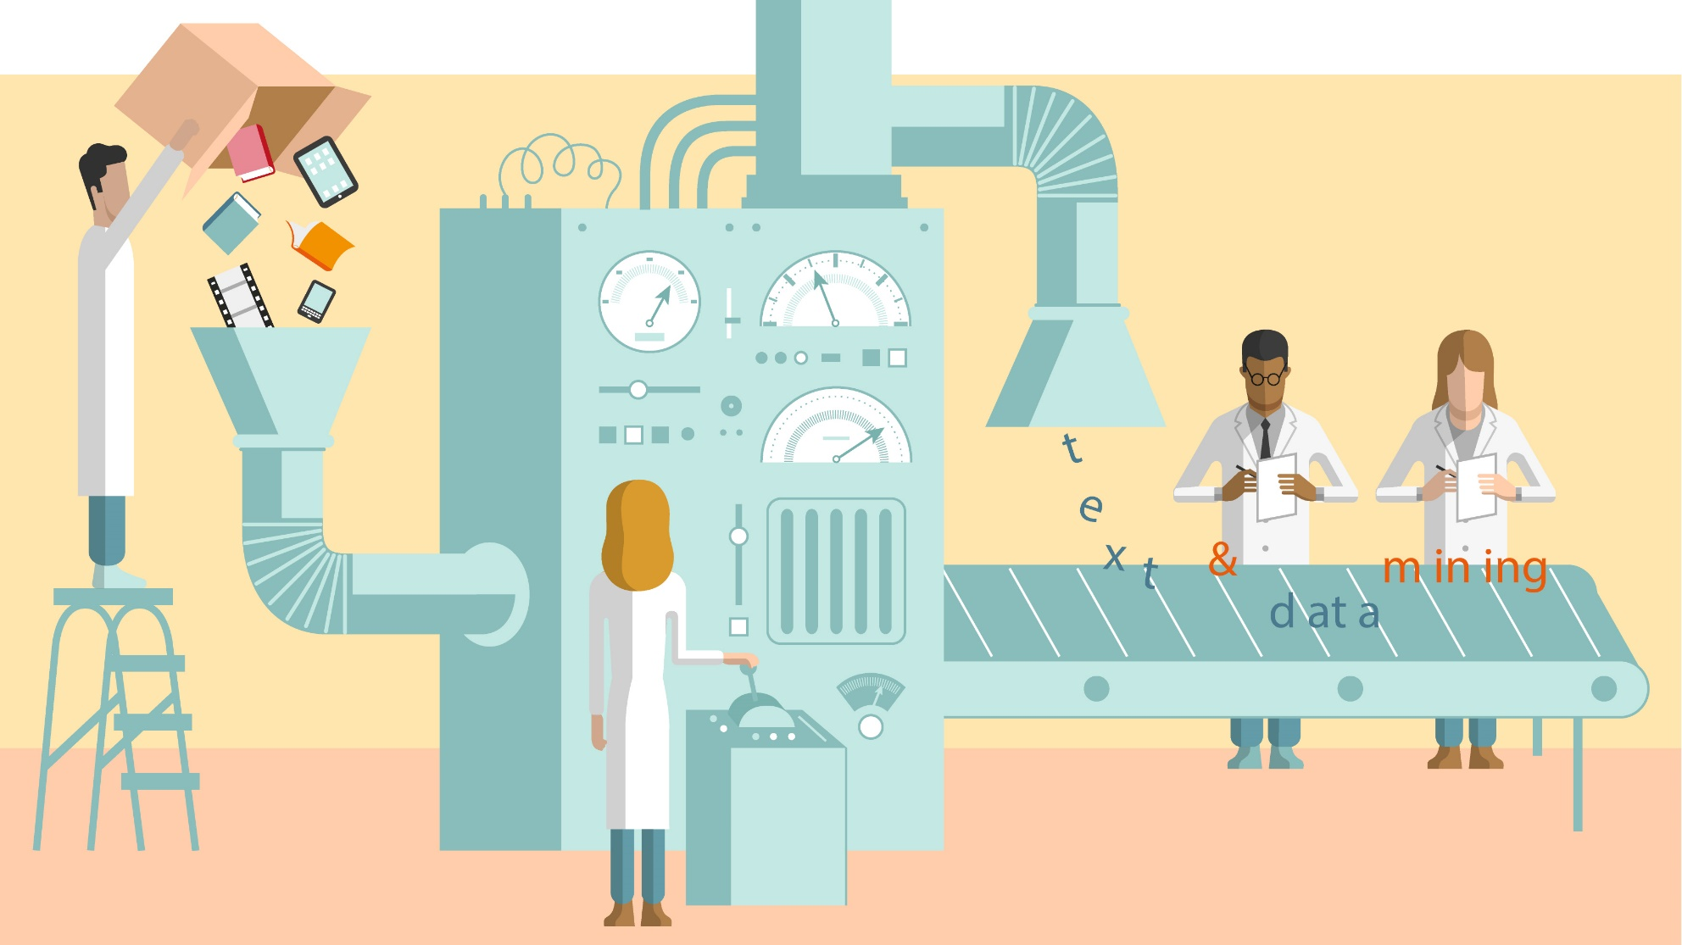
Text-mining is a form of data-mining
Notes:
So, diving right in.
Text-mining is one kind of data-mining, that (as you might have guessed) looks at text. Other kinds of data-mining might look at images, sounds, movements and many other things.
Importantly, “Data-mining” is not just a buzzword.
CLICK
It is actually a large category of research methods based around the idea of transformation.
Stuff goes in one end
Is transformed
And comes out the other end.
But WHAT exactly is it that goes into and comes out?
CLICK
In short, “unstructured data” goes in. This could include tweets, news articles, videos, DNA results and much more.
CLICK
Data! Specifically, structured data. Let’s talk a bit about that.

Slide 10
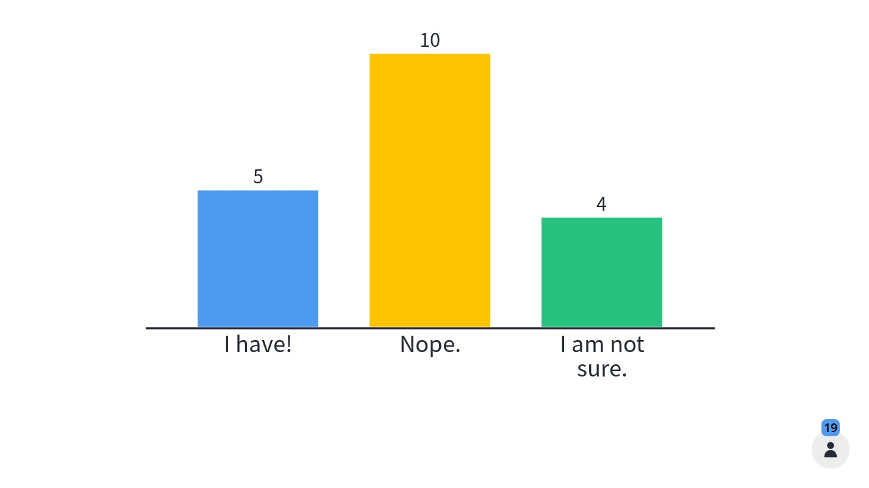
Who has used text or data-mining methods already?

Slide 11
What do I mean by structured data?
Intro to Text-Mining
02/06/20
75 attended
Notes:
When people talk about structured data, they mean the kind of data that comes in databases, excel sheets, vectors, arrays or matrices.
The data are arranged in a structured way, usually depicted as tables of columns and rows.
For example, if I wanted to track the online education sessions I have run, I would probably want to record basic information like the title of a session I gave…
CLICK
The date I first gave it…
CLICK
and the number of attendees.
Now, I could just write this on, like, a sticky note
CLICK
and tack it to my corkboard. That is exactly how some people record information.
But if I know that I will be giving LOTS of online education sessions, I might assume that I want to do something more with the information.
I might want to calculate my average attendance or plot whether my sessions are becoming more or less frequent or popular over time.
Knowing this, it is much more sensible to record the same data for each session in the same place and in the same order.

Slide 12
What do I mean by structured data? Structured titles
Intro to Text-Mining
Text-Mining
Basics
Text-Mining Advanced
Notes:
So, I could write the title of my online session
CLICK
And the date I gave it…
CLICK
and the number of attendees (this time just the number) as structured data.
CLICK
I can do this for each of my online sessions and if I keep the same format then everything in each column
CLICK
Has the same kind of contents, whether that is text
CLICK
dates
CLICK
Or whole numbers. Likewise, the rows are coherent too.
CLICK
With each row containing data from one event so that each item in a row relates to every other item in the same row.

Slide 13
What do I mean by structured data? Structured dates
Intro to Text-Mining
02/06/20
Text-Mining
Basics
16/06/20
Text-Mining Advanced
29/06/20
Notes:
So, I could write the title of my online session
CLICK
And the date I gave it…
CLICK
and the number of attendees (this time just the number) as structured data.
CLICK
I can do this for each of my online sessions and if I keep the same format then everything in each column
CLICK
Has the same kind of contents, whether that is text
CLICK
dates
CLICK
Or whole numbers. Likewise, the rows are coherent too.
CLICK
With each row containing data from one event so that each item in a row relates to every other item in the same row.

Slide 14
What do I mean by structured data? Structured attendance
Intro to Text-Mining
02/06/20
75
Text-Mining
Basics
16/06/20
72
Text-Mining Advanced
29/06/20
85
Notes:
So, I could write the title of my online session
CLICK
And the date I gave it…
CLICK
and the number of attendees (this time just the number) as structured data.
CLICK
I can do this for each of my online sessions and if I keep the same format then everything in each column
CLICK
Has the same kind of contents, whether that is text
CLICK
dates
CLICK
Or whole numbers. Likewise, the rows are coherent too.
CLICK
With each row containing data from one event so that each item in a row relates to every other item in the same row.

Slide 15

Structured data is…
…familiar
…easy
…demonstrable
Intro to Text-Mining
01/05/20
75
4 steps of Text-Mining
04/06/20
72
Text-Mining analysis
09/07/20
85
Notes:
Great! Now that we have some structured data, we can work with it.
Most of us know at least a bit about how to store, record, graph, do statistical tests and more about structured data. We know how to show our work and argue about it.
Even if I had 75 rows instead of three, I could easily work out which lesson was the best attended, or what is my average attendance or whether my online sessions are getting more or less popular over time, or MANY other things.
Importantly, if someone wanted to disagree with my results, they could take my structured data, run their own tests, show me their work and we could discuss it.
So basically, structured data is
CLICK
Familiar, easy and demonstrable.

Slide 16

What about unstructured data? Post-it notes
Seventy- two
Intro to Text-Mining 02/06/20
75 attended
Text-mining lesson #2
June 16
2020-06-29
80 - 90
Notes:
Now. UN structured data is familiar to us in our every day lives, but less familiar or easy to work with.
The actual information content might be the same even if it is jumbled up, differently formatted, poorly labelled, messy, etc.
CLICK
If I had carried on with notes pinned to my corkboard I might not always be so good at recording the same stuff…
CLICK
Or in the same order
CLICK
or using the same format
CLICK
Or I might record superfluous information, like this picture
CLICK
Of the shoes I want to wear while presenting.
So, we can see that Unstructured data is really semi-unstructured or even semi-structured data. It has structure, just maybe not as much as we would like.

Slide 17
What about unstructured data? Discrepancies
Seventy- two
Intro to Text-Mining 02/06/20
75 attended
Text-mining lesson #2
June 16
2020-06-29
80 - 90
Notes:
Now. UN structured data is familiar to us in our every day lives, but less familiar or easy to work with.
The actual information content might be the same even if it is jumbled up, differently formatted, poorly labelled, messy, etc.
CLICK
If I had carried on with notes pinned to my corkboard I might not always be so good at recording the same stuff…
CLICK
Or in the same order
CLICK
or using the same format
CLICK
Or I might record superfluous information, like this picture
CLICK
Of the shoes I want to wear while presenting.
So, we can see that Unstructured data is really semi-unstructured or even semi-structured data. It has structure, just maybe not as much as we would like.

Slide 18


Semi-(un)structured data is …
… less accessible
… difficult
… requires intuition and “common sense”
Seventy- two
Intro to Text-Mining 02/06/20
75 attended
Text-mining lesson #2
June 16
2020-06-29
80 - 90
Notes:
So, semi-structured data
CLICK
Has items with internal structure but no (or almost no) overall or coherent structure. There may be missing values, different ways to measure, record, or order the values, etc.
CLICK
We interact with semi-structured data like this every time we speak to people. But it is much less familiar or accessible to us as researchers or analysts.
It has information content, that content is harder and slower to use. The tools developed for structured data break down and people tend to ignore it as a data source or go really manual with it, maybe reading, cross-referencing, filling in gaps, re-coding it or retro-actively structuring it. Essentially, using it means becoming an expert on it.
This requires a certain amount of ‘gut instinct’, is really hard to ‘show your work’ and agreements cannot really be resolved easily.

Slide 19
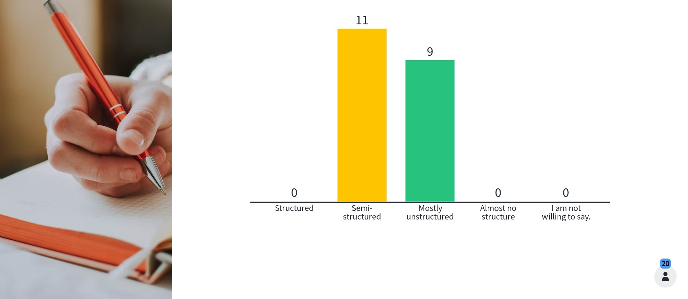
How structured is a journal?

Slide 20
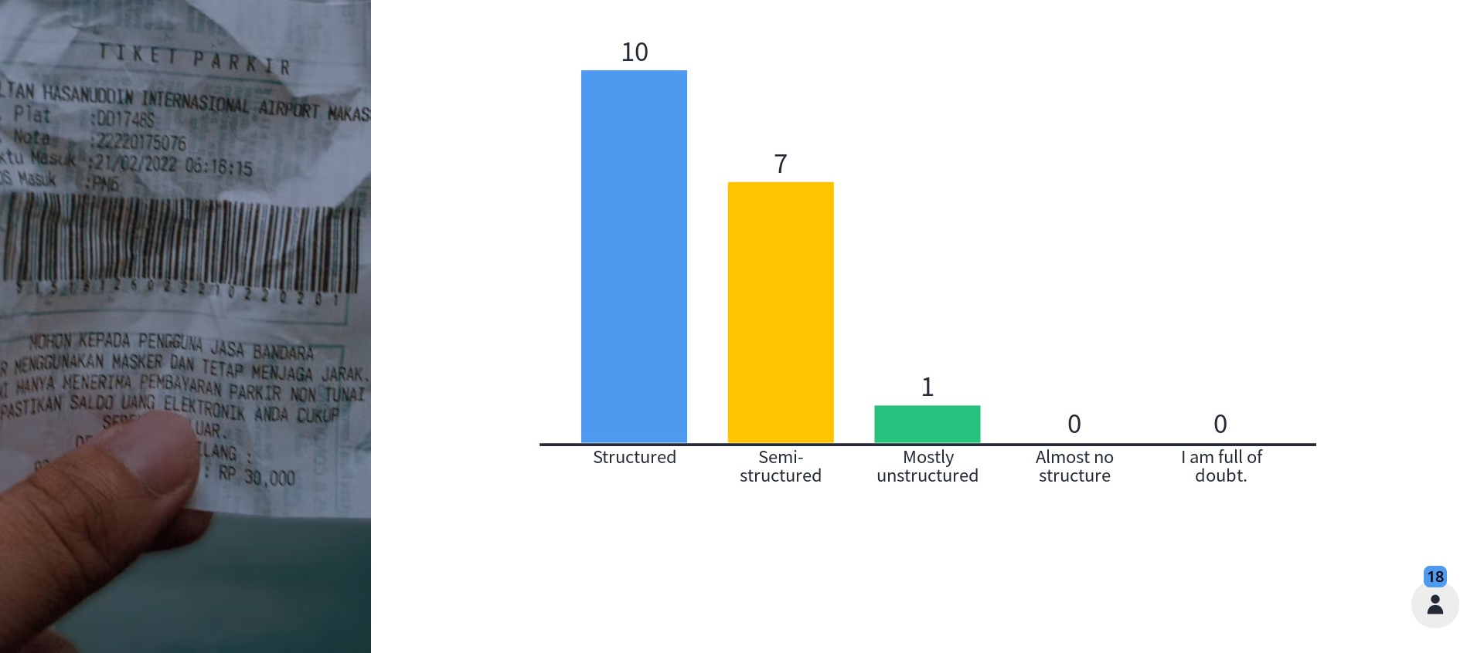
How structured is a receipt?

Slide 21
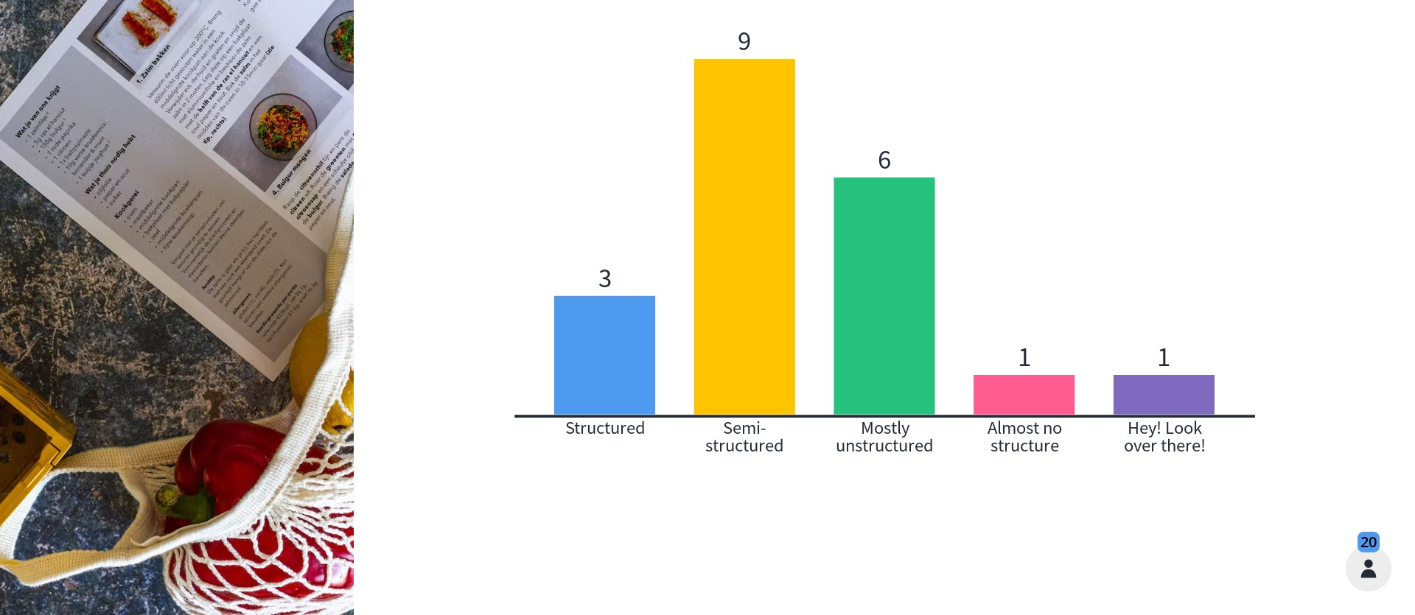
How structured is a recipe?

Slide 22
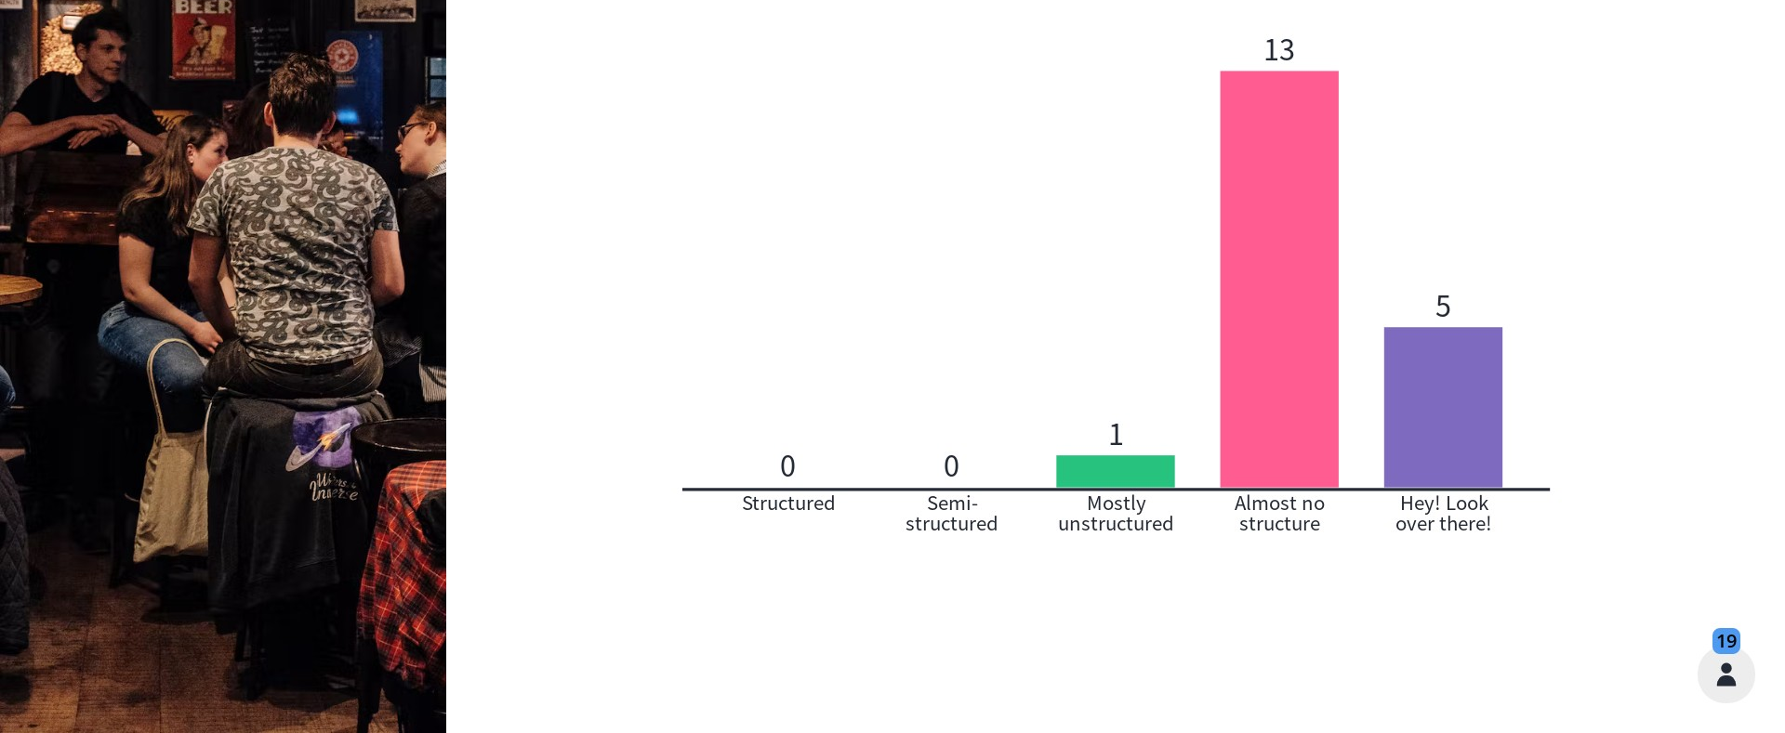
How structured is a rant down the pub?

Slide 23



Yeah… and?
Notes:
Traditionally, people just kept structured and unstructured or semi-structured data separate.
CLICK
Science handled the structured stuff and showed all the work, while
CLICK
Humanities and social science handled all the less structured stuff via lot of writing and talking and discussing interpretations.
BUT - This division has started to get a bit boring.
We don’t want to limit ourselves in how we approach problems.
We want everyone to show their work as much as possible.
And we realise that semi-structured data is not totally structure-less.
Plus, semi-structured data is growing in volume
CLICK
Way too quickly for someone to become an expert on it through manual means.
At the same time, semi-structured data is not only more common and more important to our lives, but also more accessible.
So let’s look at how text-mining turns semi-structured text data into more structured data in 4 steps.

Slide 24

Text-mining in four steps - 1
Retrieval
Processing
Analysis
Communication
SEARCH Source = MANCHESTER EVENING NEWS
Date = 01/01/1970 to 31/12/2021
Keywords = “rail” AND “electrification” AND
“north” AND “England”
Notes:
Step 1, is
CLICK
Retrieval or identifying and acquiring a relevant (and ideally representative) set of text documents.
That might be tweets featuring a certain hashtag, Blog posts with certain keywords, newspaper articles by a particular journalist, the minutes of local council meetings, just about anything.
Let’s say that I want to look at how to recognise when government projects are going to go nowhere.
I would retrieve a set of news articles or press releases about government projects, with some that are known to have been cancelled and others known to have happened.
You have to balance the desire to get ABSOLUTELY EVERYTHING that might be good to include against your resources (time, computer storage space, processer power, institutional access, etc.)
You have to compromise, but be clear about the choices you make because someone will want you to defend them.
Keep a raw copy of your acquired data. Also, if your data is the result of a search,
CLICK
keep the details of your search including the sources you used, the date range you specified, the search terms, etc.

Slide 25

Text-mining in four steps - 2
Retrieval
Processing
Analysis
Communication
Raw data - - - > 1 file/row/database entry per tweet/document/webpage
Basic NLP – correct spelling,
remove capitalisation,
substitute acronyms or alternate references
More NLP – classify words by grammatical category,
disambiguate meaning by context,
parse sentences and mark up structure
Notes:
Step 2 is Processing which is a bunch of practical steps that turn your potentially messy raw data into something that…
CLICK
A computer can read.
Use computational tools for this (e.g. the R or Python libraries) which not only keeps track of what you did (and in what order) but allows you and others to run the steps again in the future on the same, or a different, data set. Very reproducible!
I won’t go into too much detail right now, because I cover this fully in just a bit.

Slide 26

Text-mining in four steps - 3
Retrieval
Processing
Analysis
Communication
(Relative) word counts
Equivalency suggestions
Relationship discovery
Automatic categorisation
Prediction
Notes:
Step 3 is
CLICK
analysis, which is about running a particular analytical or statistical method relevant to the original research question.
This can include a wide variety of things
CLICK
From the fairly basic to the complex.
I cover a few examples of this later, but there are many more.

Slide 27

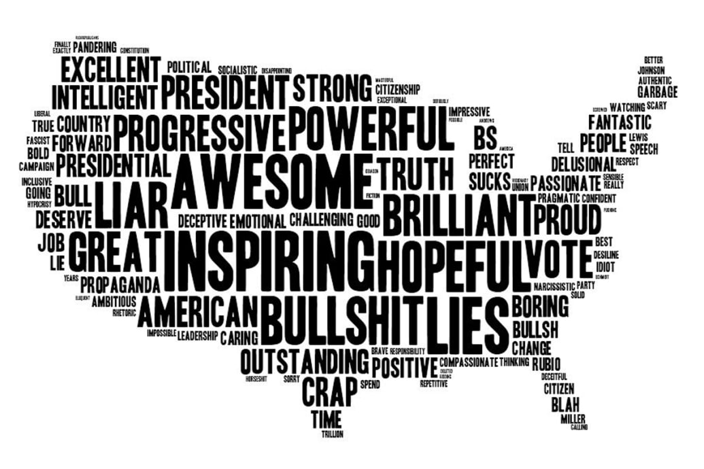
Text-mining in four steps - 4
Retrieval
Processing
Analysis
Communication
Notes:
Step 4 is communication
CLICK
And includes identifying the meaningful results of the analysis and highlighting the insights through presentation and/or visualisation. This can be difficult. For example,
CLICK This is a word cloud of one-word reactions to one of President Obama’s State of the Union addresses. Size represents frequency, but location is irrelevant.
This visualisation has a very different impact than would a simple table with words in one column and frequency counts in the next. But is the difference in impact good? Distracting? Misleading? Simply unfamiliar? Something else?

Slide 28
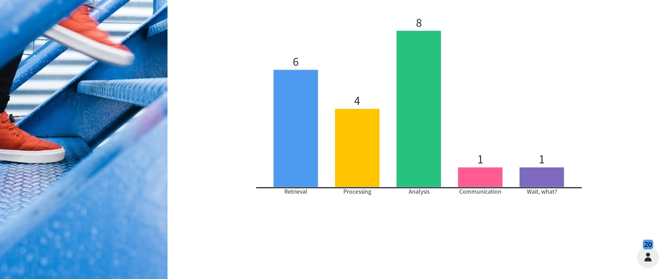
Which of these steps do you have the most experience with?

Slide 29
Text-mining Pros and Cons
Pros:
Large scale approach to difficult stuff
Can see detail of sub-groups
Novel application
Cons:
Needs a large corpus
May need a lot of manually created training data
Lack of human interaction or supervision
Unclear what questions it can/cannot address
Lops off a bunch of structure or information that is hard to capture/amplify
Notes:
By forcing semi-structured data into structured data, you remove information.
For example, standardizing spelling removes the kind of information that we get from recognizing that a text has an error or even just a non-standard variant.
US vs. UK spelling, for instance, or phat vs. Fat.

Slide 30
Let’s focus on steps 2 and 3
Retrieval
Processing
Analysis
Communication
Processing:
Tokenisation (dividing raw data)
Standardising (case, spelling, RegEx)
Removing irrelevancies (punctuation, stopwords, etc.)
Consolidation (stemming and/or lemmatising)
Basic NLP:
Tagging, Named Entity Recognition and Chunking
Analysis:
POS-tagging
Advanced Chunking
Frequency and Similarity
Classification
Relationship discovery
Etc.
Notes:
So, retrieval and analysis are both important, but they are topics for another day.
I really want to start getting into detail on steps 2 and 3.
CLICK
Processing and extraction, which are not always linear. Expect these steps to be a bit iterative.
CLICK
There is a lot involved in both steps, which you may or may not need depending on your project.

Slide 31
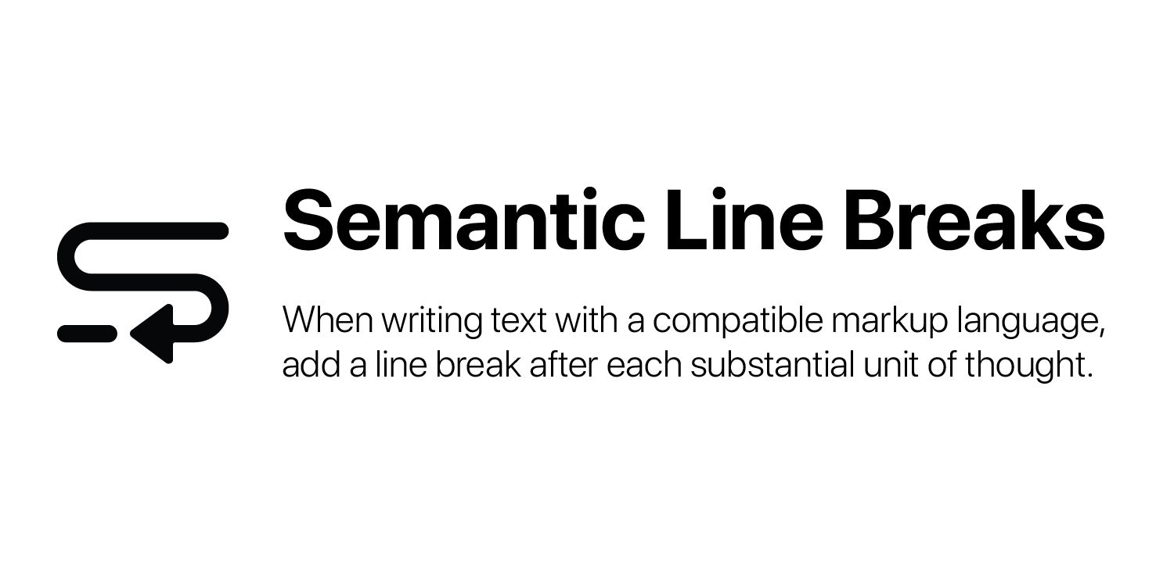


Processing – Raw data into useful data
Great big file with the text content of hundreds of newspaper articles.
You may want to:
Break it into many small files of one article each (with useful names)
Insert a line break after each article
Write out each article to a dictionary with key-value pairs for article features
[‘Author(s)’: ‘Writer1, Writer2’
‘Date’: ‘Junetember 43, 3024’
‘Headline’: ‘They started Text-Mining and you will not believe what happens next!’
‘Publication’: ‘Fake News Corp.’
‘Article’: ‘Yada yada yada, blah.’]
Notes:
First is turning raw data into something you can work with. Let’s assume you have
CLICK
A great big file with hundreds of newspaper articles in it. You might want to:
CLICK
Break it into smaller files with one article each, which is useful if you want to analyse the text itself rather than the author or date
CLICK
Insert a line break or delimiter after each article, which would be good if you wanted to move the text, title, date, author, etc. into a spreadsheet programme.
CLICK
You could also turn each article to a dictionary entry with key-value pairs for the article contents, which would a good way to discover relationships between these features and the text. For example, to find the ‘style’ of each publication, how a topic is approached differently over time, or how well headlines match article content.

Slide 32
Processing – Tokenisation
Tokens = lowest unit of natural language processing analysis.
Example:
text = "It's raining cats and dogs. It is also raining elephants, which is becoming a problem."
Tokenize by words
[
]
Tokenize by sentences
[ ]
'It'
"'s"
'raining'
'cats'
'and'
'dogs'
'.'
'It'
'is'
'also'
'raining'
'elephants'
','
'which'
'is'
'becoming'
'a'
'problem'
'.'
“It’s raining cats and dogs.”
'It is also raining elephants, which is becoming a problem. '
Notes:
Many text-mining approaches require breaking the text down further, to the lowest unit of analysis.
CLICK
That process is called tokenisation. Lot’s of things can be tokens, including whole documents, chapters, paragraphs, sentences, words, word-stems and more. The most common ones I have seen are words and sentences.
CLICK
Let’s look at an example. Imagine one of my small files, or one of my rows in a spreadsheet, or one of the fields in a dictionary key-value pair contained this string of text.
I could tokenise this string as
CLICK
Words. That means transforming it from one long string into a list of many small strings. Alternatively, I could tokenise the original string as
CLICK
Sentences. This still transforms one long string into a list of smaller strings, but in this case fewer of them.

Slide 33
Processing – Standardising
Goal is to replace multiple forms of ‘same’ token with a single form
RegEx is like find-and-replace - useful for standardising on terminology/acronyms/etc.
Example: “cats" --> “puddy-tats"
‘It's raining cats and dogs. It is also raining elephants, which is becoming a problem.’
Notes:
Next, we have standardisation which is about
CLICK
replacing multiple ways that a given word or phrase might be written with a single option. This improves analysis as otherwise the different forms would be counted as different words.
For example, spelling colour in the American or British ways, miles per hour being written out or written as ‘m’, ‘p’, ‘h’ or even just written in lowercase or uppercase.
CLICK
One tool, that I want to highlight is RegEx, which stands for Regular Expressions. It works like
CLICK
Find and replace in word processors. For example, if I want replace ‘cats’ with ‘puddy-tats’ in my text example, my original text
CLICK
Would become
CLICK
A new text that has ‘cats’ replaced with ‘puddy-tats’.
Other standardisation tools work a bit like RegEx. For example, case converters change uppercase letters into lowercase (or vice versa) and spell checkers finds commonly misspelled words and replaces them with correct ones, etc.

Slide 34
Processing – After standardising
Goal is to replace multiple forms of ‘same’ token with a single form
RegEx is like find-and-replace - useful for standardising on terminology/acronyms/etc.
Example: “cats" --> “puddy-tats"
‘It's raining cats and dogs. It is also raining elephants, which is becoming a problem.’
‘It's raining puddy-tats and dogs. It is also raining elephants, which is becoming a problem.’
Notes:
Next, we have standardisation which is about
CLICK
replacing multiple ways that a given word or phrase might be written with a single option. This improves analysis as otherwise the different forms would be counted as different words.
For example, spelling colour in the American or British ways, miles per hour being written out or written as ‘m’, ‘p’, ‘h’ or even just written in lowercase or uppercase.
CLICK
One tool, that I want to highlight is RegEx, which stands for Regular Expressions. It works like
CLICK
Find and replace in word processors. For example, if I want replace ‘cats’ with ‘puddy-tats’ in my text example, my original text
CLICK
Would become
CLICK
A new text that has ‘cats’ replaced with ‘puddy-tats’.
Other standardisation tools work a bit like RegEx. For example, case converters change uppercase letters into lowercase (or vice versa) and spell checkers finds commonly misspelled words and replaces them with correct ones, etc.

Slide 35
Processing – Removing irrelevancies
Stop words and punctuation
'It'
"'s"
'raining'
'cats'
'and'
'dogs'
'.'
'It'
'is'
'also'
'raining'
'elephants'
','
'which'
'is'
'becoming'
'a'
'problem'
'.'
Notes:
Other things you might want to remove
CLICK
Are stop words and punctuation.
Stop words are usually determiners, conjunctions, adverbs and the like. Punctuation and stop words both matter a lot for sentence-wide meaning, but have little actual content as individual tokens and tend to have more or less the same distribution in text so don’t help you analyse text much.
Many text-mining approaches just remove them, which if we do to our text…
CLICK
Produces
CLICK
A new list of word tokens that are just about interpretable for humans but easily interpretable for computers.

Slide 36
Processing – after removing irrelevancies
Stop words and punctuation
'It'
"'s"
'raining'
'cats'
'and'
'dogs'
'.'
'It'
'is'
'also'
'raining'
'elephants'
','
'which'
'is'
'becoming'
'a'
'problem'
'.'
'It'
'raining'
'cats'
'dogs'
'It'
'also'
'raining'
'elephants'
'becoming'
'problem'
Notes:
Other things you might want to remove
CLICK
Are stop words and punctuation.
Stop words are usually determiners, conjunctions, adverbs and the like. Punctuation and stop words both matter a lot for sentence-wide meaning, but have little actual content as individual tokens and tend to have more or less the same distribution in text so don’t help you analyse text much.
Many text-mining approaches just remove them, which if we do to our text…
CLICK
Produces
CLICK
A new list of word tokens that are just about interpretable for humans but easily interpretable for computers.

Slide 37
Basic NLP – Consolidation
Lemmatising or stemming
'It'
"'s"
'raining'
'cats'
'and'
'dogs'
'.'
'It'
'is'
'also'
'raining'
'elephants'
','
'which'
'is'
'becoming'
'a'
'problem'
'.'
Notes:
Consolidation gets into natural language processing and is a language-specific way to turn various linguistic forms of the ‘same word’
CLICK
into one form of that word. Lemmatising and stemming are both ways to
CLICK
strips back word markers (e.g. verb endings, plurals, etc.) in subtly different ways.
CLICK
We get a new list of text tokens
CLICK

Slide 38
Basic NLP – after consolidation
Lemmatising or stemming
'It'
"'s"
'raining'
'cats'
'and'
'dogs'
'.'
'It'
'is'
'also'
'raining'
'elephants'
','
'which'
'is'
'becoming'
'a'
'problem'
'.'
'It'
'be'
'rain'
'cat'
'and'
'dog'
'It'
'be'
'also'
'rain'
'elephant'
'which'
'be'
'become'
'a'
'problem'
Notes:
Consolidation gets into natural language processing and is a language-specific way to turn various linguistic forms of the ‘same word’
CLICK
into one form of that word. Lemmatising and stemming are both ways to
CLICK
strips back word markers (e.g. verb endings, plurals, etc.) in subtly different ways.
CLICK
We get a new list of text tokens
CLICK

Slide 39
Basic NLP – Part of Speech tagging
'It'
'raining'
'cats'
'dogs'
'It'
'also'
'raining'
'elephants'
'becoming'
'problem'
Notes:
Next up, Part of speech tagging, which also uses language-specific structure.
CLICK
POS-tagging can start with raw or processed text. In this case, we are POS tagging text that has already had stopwards and punctuation removed. The tagging
CLICK
produces
CLICK
A new list of text tokens paired with a POS-tag.
Different Part of speech taggers will return different kinds of tags.
This one has returned pronoun tags, verb in gerund form tags, nouns in plural form tags, basic adverb tags (RB) and noun in singular form tags.

Slide 40
Basic NLP – after POS tagging
'It'
'raining'
'cats'
'dogs'
'It'
'also'
'raining'
'elephants'
'becoming'
'problem'
('It', 'PRN’)
('raining', ‘VBG’)
(‘cats', ‘NNS’)
(‘dogs', ‘NNS’)
('It', 'PRN’)
(‘also', ‘RB’)
('raining', ‘VBG’)
(‘elephants', ‘NNS’)
(' becoming', ‘VBG’)
(‘problem', ‘NN’)
Notes:
Next up, Part of speech tagging, which also uses language-specific structure.
CLICK
POS-tagging can start with raw or processed text. In this case, we are POS tagging text that has already had stopwards and punctuation removed. The tagging
CLICK
produces
CLICK
A new list of text tokens paired with a POS-tag.
Different Part of speech taggers will return different kinds of tags.
This one has returned pronoun tags, verb in gerund form tags, nouns in plural form tags, basic adverb tags (RB) and noun in singular form tags.

Slide 41
Basic NLP – Chunking
('It', 'PRN’)
(‘s', ‘VBZ’)
('raining', ‘VBG’)
(‘cats', ‘NNS’)
(‘and’, ‘CC’)
(‘dogs', ‘NNS’)
(‘.’, ‘PUN’)
Notes:
Another useful basic NLP process is chunking, which requires word tokenised and POS-tagged text as input and builds it back up into larger structures that have logical relationships.
CLICK
Importantly, this works best if you have NOT put the text through all the standardisation and consolidation processes.
CLICK
If we put this through a chunker it returns…
CLICK
Text that has relevant linguistic groupings, like sentences. Note, I have displayed this visually to make it easy for humans to read. What is ACTUALLY returned is not quite so easy to read.
CLICK
Although it is in a format the computers find easy to read.

Slide 42
Basic NLP – after chunking
('It', 'PRN’)
(‘s', ‘VBZ’)
('raining', ‘VBG’)
(‘cats', ‘NNS’)
(‘and’, ‘CC’)
(‘dogs', ‘NNS’)
(‘.’, ‘PUN’)
S
('It', 'PRN’)
(‘s', ‘VBZ’)
('raining', ‘VBG’)
(‘cats', ‘NNS’)
(‘and’, ‘CC’)
(‘dogs', ‘NNS’)
(./.)
(S It/PRP 's/VBZ raining/VBG cats/NNS and/CC dogs/NNS ./.)
Notes:
Another useful basic NLP process is chunking, which requires word tokenised and POS-tagged text as input and builds it back up into larger structures that have logical relationships.
CLICK
Importantly, this works best if you have NOT put the text through all the standardisation and consolidation processes.
CLICK
If we put this through a chunker it returns…
CLICK
Text that has relevant linguistic groupings, like sentences. Note, I have displayed this visually to make it easy for humans to read. What is ACTUALLY returned is not quite so easy to read.
CLICK
Although it is in a format the computers find easy to read.

Slide 43
Basic NLP – Named Entity Recognition (a kind of chunking)
(‘Bruce', ‘NNP’)
(‘Wayne', ‘NNP’)
('is', ‘VBZ’)
(‘the', ‘DT’)
(‘CEO', ‘NN’)
(‘of’, ‘IN’)
(‘Wayne', ‘NNP’)
(‘Enterprises', ‘NNP’)
(‘,’, ‘PUN’)
(‘but’, ‘CC’)
('is', ‘VBZ’)
(‘also', ‘RB’)
(‘Batman', ‘NNP’)
(‘.’, ‘PUN’)
Notes:
A particular kind of chunking operation that you might find useful is Named Entity Recognition, which finds sentence chunks as well as noun phrase chunks.
Starting with a different sample text
CLICK
A named entity recognition chunker
CLICK
Returns

Slide 44
Basic NLP – Named Entity Recognition
S
PERSON
ORGANIZATION
(‘Bruce', ‘NNP’)
(‘Wayne', ‘NNP’)
('is', ‘VBZ’)
(‘the', ‘DT’)
ORGANIZATION
(‘CEO', ‘NN’)
(‘of’, ‘IN’)
(‘Wayne', ‘NNP’)
(‘Enterprises', ‘NNP’)
(,/,)
PERSON
(‘but’, ‘CC’)
('is', ‘VBZ’)
(‘also', ‘RB’)
(‘Batman', ‘NNP’)
(./.)
Notes:
A more complex output with hierarchical groups.
We still have the big sentence-wide group.
But we also have some groups within the sentence, like Bruce, Wayne, CEO of Wayne Enterprises, and Batman.
Some are accurate. Bruce and Batman are both people.
But some are not 100%. Wayne is sometimes an organisation and sometimes not.

Slide 45
Processing and/or Basic NLP - What to do and in what order?
Chunking and/or POS-lemmatising requires text that is already tokenised and POS-tagged.
RegEx may be best before removing uppercase to better catch acronyms or abbreviations.
Add changes to a pipeline and run the whole thing from scratch.
Replicability is important!
Pipeline
Pipeline
Tokenisation
POS-tagging
Lemmatising
Remove punctuation/stop words
Tokenisation
Remove punctuation
Remove stop words
Stemming
Notes:
I can’t tell you which of these processes you will need to do or in what order to do them, but there are some rules of thumb
CLICK
And some common sense steps to take
CLICK
But most of the time you have to do some experimentation, some thinking, some strategizing. For example, you may get a long way through your analysis before you notice an abbreviation or acronym that would be better solved with RegEx early on.
You need to consider this to be an iterative process, which means
CLICK
you probably want to add a step into a pipeline of steps that take the output of the previous as the input to the next. You may also need to run this whole pipeline from scratch after you insert a new step into the middle somewhere, because otherwise it will be hard to keep track. Always work with a copy of your raw data rather than the original raw data itself.
CLICK
Always keep track! Write what you do, when and why, so that others can reproduce your workflow.

Slide 46
Analysis - Word Frequency
'It'
"'s"
'raining'
'cats'
'and'
'dogs'
'.'
'It'
'is'
'also'
'raining'
'elephants'
','
'which'
'is'
'becoming'
'a'
'problem'
'.'
Pipeline
Word tokens
Remove uppercase, punctuation, stop words, empty strings
Stemming
Count
Example:
{'It': 2, 'raining': 2,
'cats': 1, 'dogs': 1, 'also': 1, 'elephants': 1, 'becoming': 1, 'problem': 1}
Notes:
Now, we have gotten into the analysis phase, which is about addressing the research question, the problem to solve, or the interesting pattern to explore.
A popular starting point is to look at word frequency, which is a fast way to get a sense of what a text is like or is ‘about’. Image two essays on the same topic. The most common words in one are “good”, “stuff” and “dude” while the most common words in the other are “appropriate” “matter” and “individual”. Even though they may express the same intent, one might be judged as more conversational and the other as more academic, just based on simple word frequencies.
Let’s look at how it works in practice. Our sample text
CLICK
Goes through a pipeline of these steps and
CLICK
Comes out as a dictionary of words paired with a count of occurrences in the text.
A less trivial example…

Slide 47
Analysis – advanced word frequency
The entire text of ‘Emma’ by Jane Austen
(available through nltk.corpus.gutenberg functions)
Pipeline
Word tokens
Remove uppercase, punctuation, stop words, empty strings
Stemming
Count
10 most common words =
{'mr', 1855, 'emma', 865, 'could', 837, 'would', 821, 'miss', 614, 'must', 571, 'harriet', 506, 'much', 486, 'said', 484, 'think', 467}
Count of the word ‘common’ = 142
Notes:
Like the entire text of a novel…
CLICK
Put through the same pipeline returns …
CLICK
A more interesting dictionary. The 10 most common words are shown here.
Alternatively, we can return the count for any target word that we might choose, like
CLICK
The word ‘common’ which appears 142 times.

Slide 48
Analysis – Word similarity
Uses concepts of 'word vectors’ (built into packages like spaCy)
Score included words on 300 dimensions derived from
How the word is used in large corpora of natural language
Part of speech, etc.
What words are typically found before or after
Etc.
Word-to-Word similarity returns a score between 0 (no similarity) and 1 (identical).

Slide 49



Analysis – Word similarity scores
 | TROLL | ELF | RABBIT
TROLL | 1 | 0.4 | 0.29
ELF | 0.4 | 1 | 0.34
RABBIT | 0.29 | 0.34 | 1
Notes:
So, let’s say we have 3 words
CLICK
Troll
CLICK
Elf and
CLICK
Rabbit.
All three are nouns, so somewhat similar, but two are fictional creatures so should be more similar.
CLICK
Indeed, we find that to be the case.
Each word pairing returns one when the word is compared to itself and something between 0 and 1 when compared to another word.
Troll and elf are more similar to each other than either is to rabbit.
Interestingly, rabbit is more similar to elf than to troll, possibly because rabbits and elves are used more often together or in similar context than rabbits and trolls.

Slide 50
Analysis – Document similarity
Document similarity works in a comparable way:
Document vectors are created (no pre-loaded document vectors)
2 or more document vectors are compared
Returns value between 0 and 1
‘Emma’ and ‘Persuasion’, both by Jane Austen = 0.99
‘Emma’ by Austen and ‘Julius Caesar’ by Shakespeare = 0.97
‘Emma’ by Austen and ‘Firefox’ from Webtext corpus = 0.86
Notes:
Document similarity
CLICK
For example
CLICK

Slide 51
Advanced analysis… Automatic classification – a thought experiment
100,000 old scientific articles to be sorted into which modern scientific field they match best
No keywords, not published in journals or published in journals that don’t match current fields, use old terminology, etc.
Rather than read and manually classify them all, how about we teach a computer to classify them for us, which requires:
A set of documents
A set of classes to which the documents may belong.
A tool that predicts what classes the documents might belong to
Notes:
We all understand the concept of sorting things into categories. We have been doing it for most of our lives. But imagine if the things we wanted to sort were really difficult.
CLICK
Like 100,000 old scientific articles that we wanted to sort into modern scientific fields or disciplines to get a better sense of the development of those fields.
CLICK
Depending on the age of those articles, they may not have keywords or abstracts, may not have been published in journals or at least not in journals that we understand as relating directly to modern fields, may not use terminology that we understand well, may not have used titles in the way that we do now, etc. etc.
Basically, all the easy ways that we would think to sort them quickly may not be available to us.
We certainly don’t want to read 100,000 old articles ourselves. Especially since multiple people would need to read them all so we can get subjectivity measures.
CLICK
Instead, we can ask a computer to do it for us or, more accurately, to create a probability measure of which category each article might belong to. We can then go over and review a percentage of cases to see how much we agree with the computer’s judgements. We can also review the borderline cases to apply critical thinking.
But how do we get a computer to do that?

Slide 52


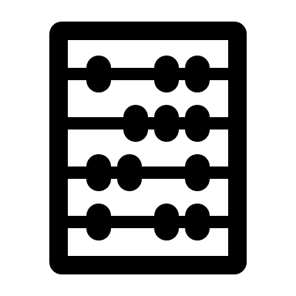


Classification returns:
A prediction about what class a new document belongs to
A number between 0 and 1 for each class
= 0.54 0.25 0.05 0.0001
= 0.71 0.37 0.12 0.09
= 0.92 0.58 0.01 0.001
Notes:
What it actually returns is a
CLICK
prediction of belonging, which is typically a number between zero (definitely does not belong) and 1 (absolutely belongs) for each class.
For our scientific article example,
CLICK
This might look like a .54 probability that this document is a physics article, a .25 probability that it is a math article, a .05 probability that it is a biology articles and a .0001 probability that it a bananas article. I just liked the banana as an icon.
Now, the tool would return different probabilities for different articles, so that
CLICK
This article is very likely to be a biology article, might also be a bananas article, probably not physics or math while
CLICK
Another article is almost certainly bananas, could be biology very unlikely to be physics or math.
But how does the tool actually make these predictions?
Well…

Slide 53



Machine learning
A training set of documents that are already correctly classified.
Train a model or learning algorithm on the training set.
A test set of documents that are already correctly classified.
Test the model, comparing performance to a benchmark if possible.
Notes:
Classification probabilities depend on teaching a machine what is associated with each class. This is achieved by taking a
CLICK
training set of documents that is correctly (and probably manually) classified and using it to train a
CLICK
Learning algorithm, which does a fancy-pants version of word-frequency counts to find the most common words or combination of words that are associated with each category.
For example, words like ‘quantum’ or ‘boson’ or ‘quark’ probably only occurs in physics articles, so if a document has one or more of those words, it is very probably a physics paper. Likewise, biology articles have their own words or phrases that are more or less unique to biology, and maths has its own, etc. etc.
Then, you need to test your algorithm
CLICK
On a test set of documents, also correctly classified, that the learning algorithm has not yet seen.
CLICK
Your learning algorithm should do as well or better than a benchmark, which might just be people or it might be previous learning algorithms.
Performance has a few components, and you may want to only focus on improving on one of them.
Accuracy refers to how many predictions our model makes that are completely correct.
Precision describes the ratio of true positives to true positives plus false positives in our predictions.
Recall describes the ratio of true positives to true positives plus false negatives in our predictions.

Slide 54


Sentiment analysis
Training & test sets = csv/data frame/etc. of texts tagged ‘pos’ or ‘neg’
Learning algorithm = spaCy/nltk/other nlp option
Benchmark not always relevant, performance metrics still are
Notes:
Sentiment analysis is a classification task. Instead of classes like ‘physics’ or ‘maths’ or ‘biology’, there would be classes like ‘positive’ and ‘negative’ or sometimes also ‘neutral’.
There are training and test sets
CLICK
already available, if you want to use them but you can make your own training and test sets too.
There are also
CLICK
Tools and pre-trained models available, if you want to do basic sentiment analysis. But, if you want to do something new or specific, you may need to train your own classifier on your own training data.
CLICK
If you are doing an entirely novel task or using entirely novel training sets, benchmarks may not be available or relevant. Performance metrics still are and you have to be clear about how your model scores on the different metrics, which ones you are trying to optimise, etc.
You optimise them by updating your classifier with new training data. You need to be clear about why you update it, what data you use to update it, what effect that has on the performance, etc.
Let’s take a closer look at how sentiment analysis and model training works.

Slide 55
Sample training and test data
train = [
('I love this sandwich.', 'pos'),
('this is an amazing place!', 'pos'),
('I feel very good about these beers.', 'pos'),
('this is my best work.', 'pos'),
("what an awesome view", 'pos'),
('I do not like this restaurant', 'neg'),
('I am tired of this stuff.', 'neg'),
("I can't deal with this", 'neg'),
('he is my sworn enemy!', 'neg'),
('my boss is horrible.', 'neg')]
test = [
('the beer was good.', 'pos'),
('I do not enjoy my job', 'neg'),
("I ain't feeling dandy today.", 'neg'),
("I feel amazing!", 'pos'),
('Gary is a friend of mine.', 'pos'),
("I can't believe I'm doing this.", 'neg')]
Notes:
Imagine that we have a prepared training set and that it looks like
CLICK
This. Each item in this set is a string and each item has a class, either ‘pos’ or ‘neg’.
Similarly, we have a prepared test set and it looks like
CLICK
This. It is more or less the same as our training set, but shares no documents in common. Although we have prepared training and test data sets, let’s imagine that we need to train our own classifier, which is likely to be a naïve bayes classification tool (there are other options).
CLICK
These take the training data that you pass to them, extract features from the string and associate those features with being either ‘pos’ or‘neg’.
Then, for testing, the trained classifier sums up the features and finds, on balance, whether the test sentence is likely to be ‘pos’ or ‘neg’.
This is a bit like trying to reverse engineer a marking criteria based on marked exam papers, and then applying your reverse engineered criteria to unmarked papers.
The accuracy, both for the sentiment analyser or for a reverse engineered marking criteria, would be to compare the decisions made in the test set to the scores assigned in the test data or the marks given by the real marking criteria.

Slide 56
Training and testing
Training = associates features (words) to scores
Example: word1 = ‘pos’,
word2 = ‘pos’,
…
wordn = ‘neg’
Test = sums feature associations to get probable score
Example: ‘pos’ + ‘neg’ + ‘pos’ = ‘pos’
Notes:
Imagine that we have a prepared training set and that it looks like
CLICK
This. Each item in this set is a string and each item has a class, either ‘pos’ or ‘neg’.
Similarly, we have a prepared test set and it looks like
CLICK
This. It is more or less the same as our training set, but shares no documents in common. Although we have prepared training and test data sets, let’s imagine that we need to train our own classifier, which is likely to be a naïve bayes classification tool (there are other options).
C

Slide 57
Naïve Bayes Classification – basic frequency in action
Training = 'I' 'love' 'this' 'sandwich' (pos) plus 'I' "can't" 'deal' 'with' 'this' (neg)
'love' 'sandwich' "can't" 'deal' 'with’
'I' 'this' 'I' 'this’
Test = ‘I deal with sandwiches’ (neg)
'I deal with sandwiches’
Prediction = ‘neg’ Actual = ‘neg’
Prediction strength = –0.25.
There are more sophisticated options if you want a custom naïve bayes classifier.
Notes:
Let’s look at an example.
CLICK
Imagine my entire training data set was these two sentences, one positive and one negative. Each sentence has some unique words and some shared words. The extracted features
CLICK
would be that love and sandwich are positive while can’t, deal and with are negative. I and this are neutral as they both appear in both sentences.
CLICK
If our test sentence is ‘I deal with sandwiches’ the sentiment analyser would find
CLICK
one neutral word, two negative words and one positive word. It would probably return a prediction of
CLICK
‘neg’, but which numerically might be a -0.25. “I deal with sandwiches” isn’t strongly negative, but it is more negative than it is positive because “deal with” implies hassle or bother. As the prediction matched the real class assigned to the sentence, our accuracy rating would be good.
CLICK
You can specify more sophisticated classifiers. They can look at co-occurrence, semantic roles, keywords, and more rather than simple frequency, or they can give more weight to first or last words. There are a lot of options that might be more or less suitable, depending on the research question and data set.

Slide 58
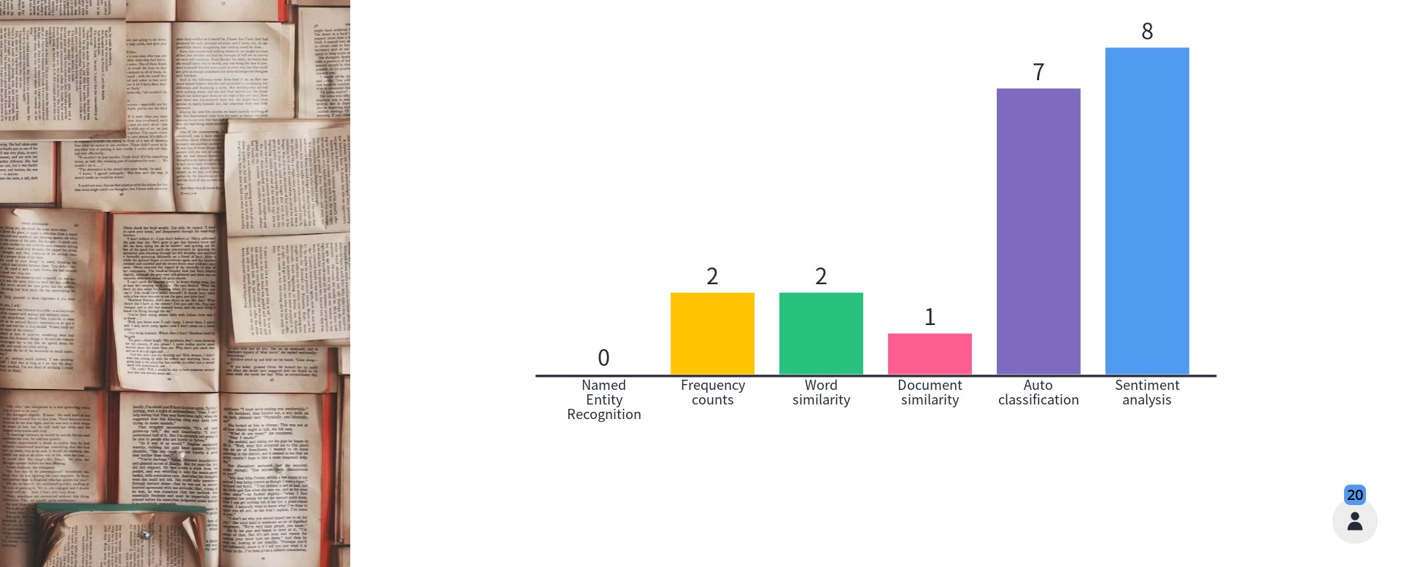
Which of these text-mining methods is most interesting to you?

Slide 59
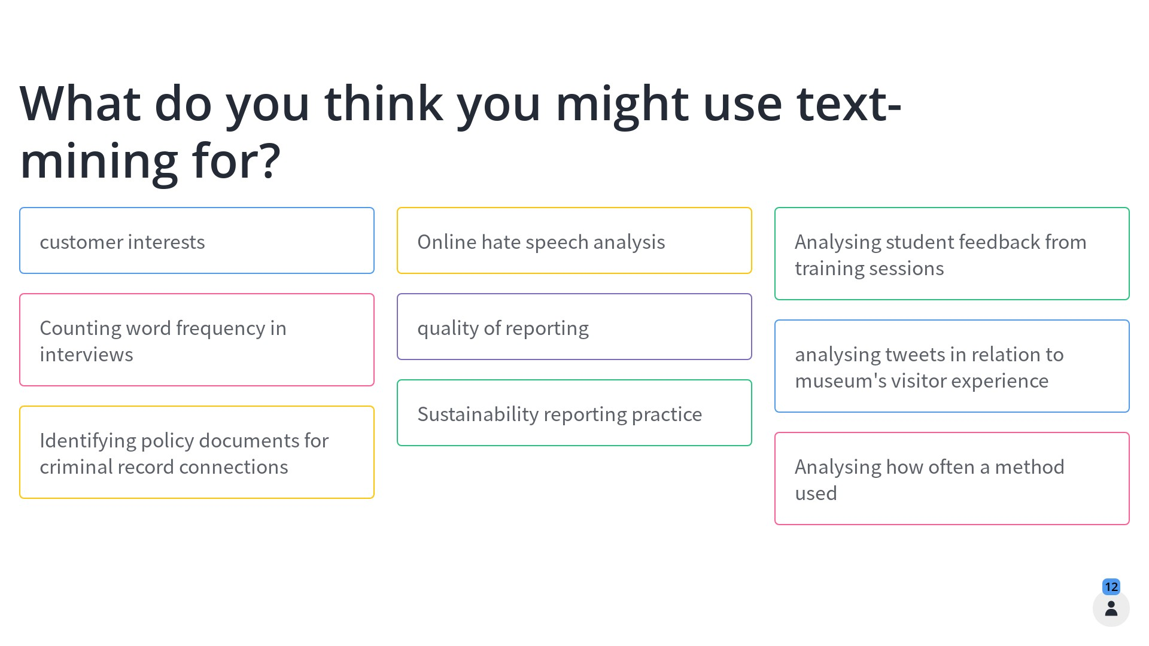
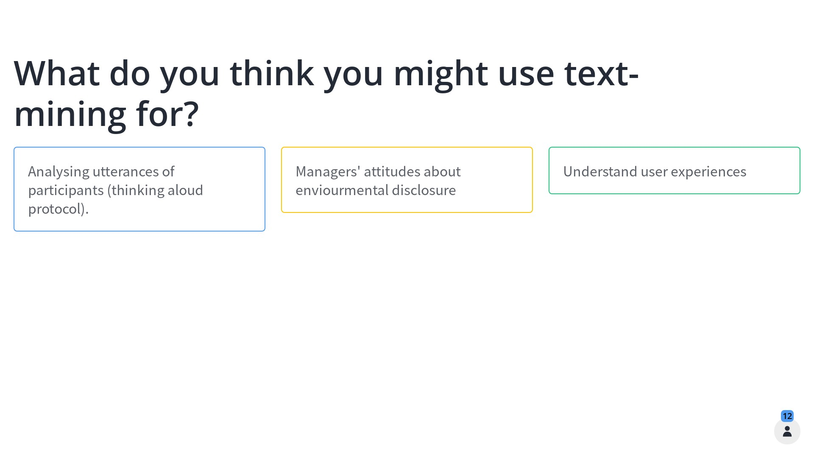
What do you think you might use text-mining for?

Slide 60


Efficiency
Real training and test data sets are huge.
Processing will reduce the number of (irrelevant) features to be extracted/evaluated.
love, loves, loving …
deal, deals, dealing …
love
deal
Notes:
The sentiment analysis training and test data sets I showed you here are TRIVIALLY small.
CLICK
Real ones have tens of thousands, hundreds of thousands, or even millions of items.
Training a classifier on a very big data set means associating the score with EVERY FEATURE in the training set, which can be VERY computationally intensive. Many of those features won’t be relevant, so if resources are tight…
CLICK
You should process your training data to reduce the number of, hopefully irrelevant, features like punctuation, stop words, different forms of the ‘same words’ etc.
Your computer will be much less happy trying to extract the features for unprocessed text
CLICK
That it would be trying to extract the features for processed text
CLICK
So, unless your research really needs extracted features for different word forms, do the processing!

Slide 61
Useful python packages
Natural Language Toolkit (nltk) and nltk.corpus
spaCy
Semantic vectors package

Slide 62
Links to code, books and resources
Our Jupyter Notebooks https://tinyurl.com/y67g3jne
Geometry and Meaning, by Dominic Widdows https://web.stanford.edu/group/cslipublications/cslipublications/site/1575864487.shtml
Programming with Python for Social Scientists. Brooker, 2020.
https://study.sagepub.com/brooker
Automate the Boring Stuff with Python: Practical Programming for Total Beginners, Sweigart, 2019. ISBN-13: 9781593279929
SentDex, python programming tutorials on YouTube https://www.youtube.com/user/sentdex

Slide 63
If you want more...
Recordings of the original, unabridged webinar -
Intro https://youtu.be/wFz1n-z_dvY
Basic Processes https://youtu.be/T6K7BibhSTA
Advanced Options https://youtu.be/pEs3jOlwbaI
Jupyter Notebooks (all 4 available here https://tinyurl.com/y67g3jne)
Text-mining Basics: Processing text
Text-mining Basics: Extraction
Text-mining: Classifiers and sentiment analysis
Text-mining: Named Entity Extraction and Social Network Creation
Notes:
If this presentation piques your interest and you want to know more, you can find the original, unabridged versions of all three talks on youtube within the UK Data Service channel
You can also find 4 different Jupyter Notebooks, which are interactive online coding notebooks, hosted on the UKDS github pages.
These allow you to work through all of the steps I cover here, and a few more in depth steps, right in your browser, with no need to download or install anything.
I have posted all of these links in the chat to make it easy for you to follow them later.

Slide 64

Thank you.
Dr. J. Kasmire
Email j.kasmire@manchester.ac.uk
@JKasmireComplex on Twitter
@JKasmireComplex@mastodonapp.uk
@UKDataService on Twitter

